Slide 1
Visitor Pattern
Behavioral Design Patterns
Muhammad Sabah-Allah

Slide 2
// allow you to add or provide new operations and methods
// to an object without changing that object itself
// new functionality is kept in separate object (Visitor Object)
// accept method ==> takes in visitor object
// accept method ==> provides visitor object access to main object

Slide 3
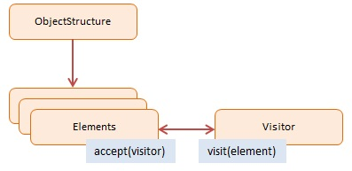

Slide 4
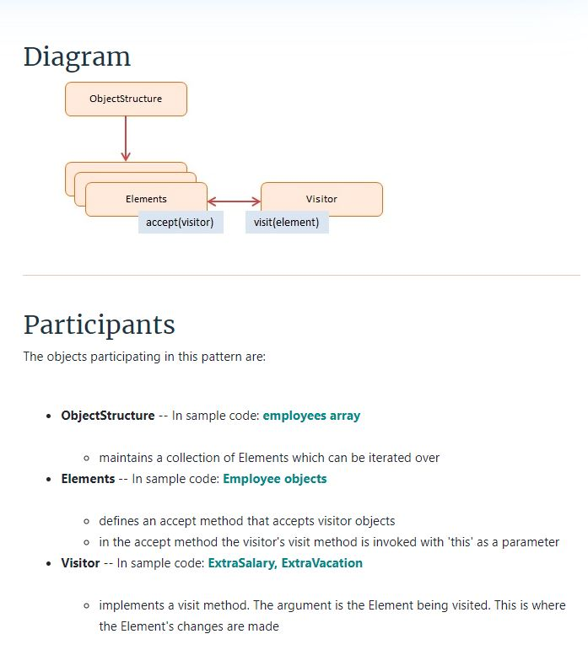

Slide 5
Thank You

